Slide 1
AR 4.0
Coming January 2017

Slide 2
What is Ar 4.0?
An App Model approach for the AR application
New “Tab” Solution for AR Entry and Display
Enhancements to Search
Improved Discussion section
Improvements to Attachments
Easier Approval
Enhanced Print capabilities
More stability and future sustainability

Slide 3
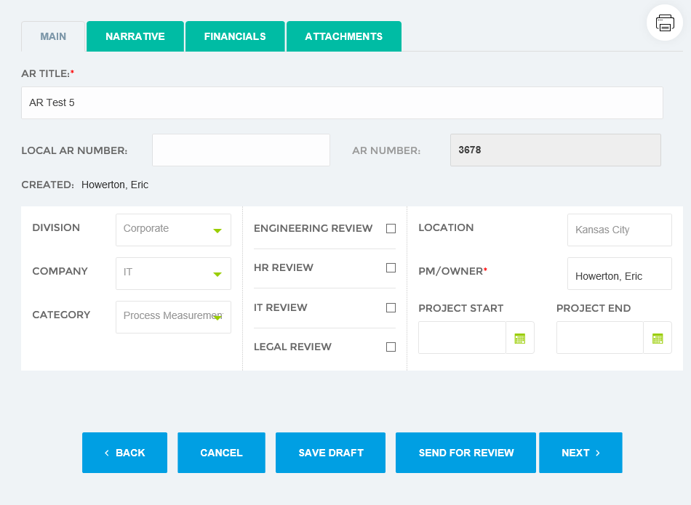
Main Tab
AR Title
Division
Company
Category (new)

Slide 4
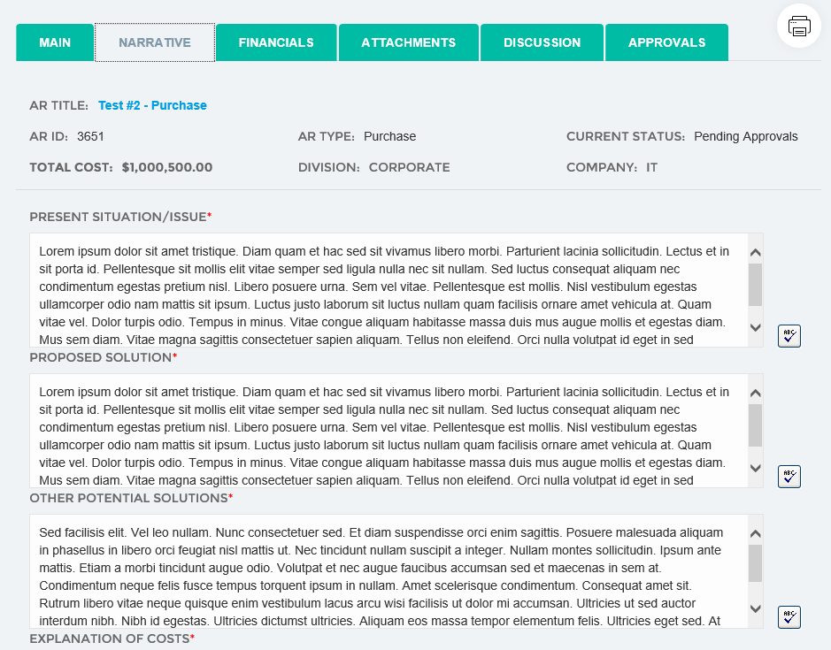
Narrative Tab
Present Situation
Proposed Solution
Other Solutions

Slide 5
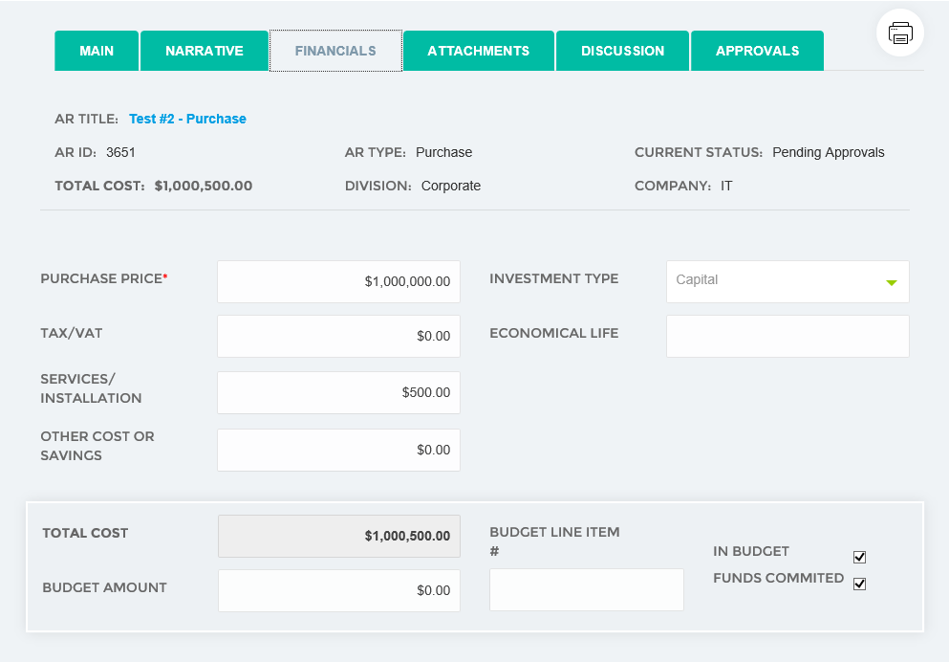
Financials Tab
All key financial data
By AR Type

Slide 6
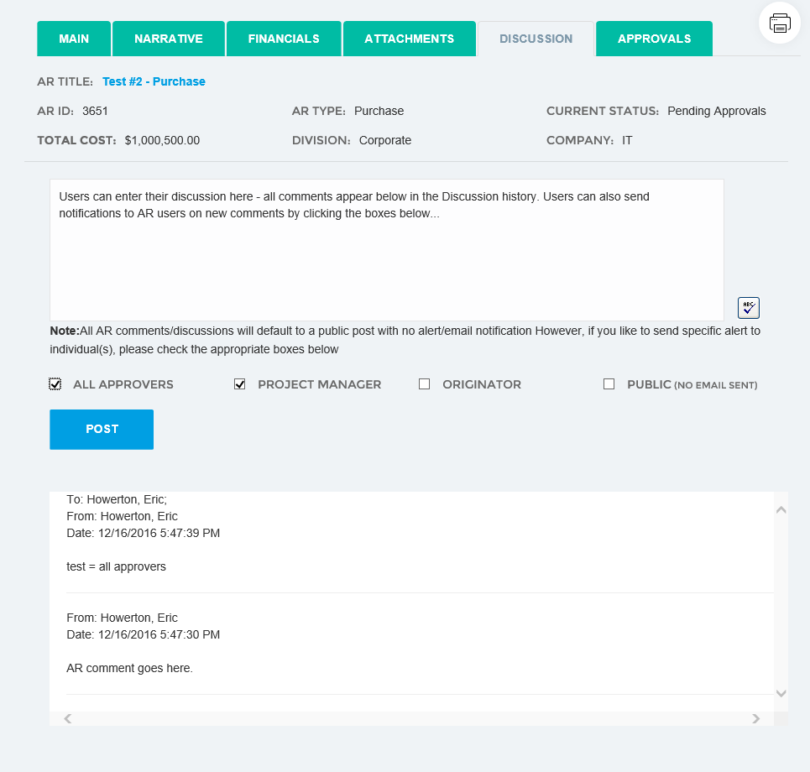
Discussion Tab
New comments
Ability to notify users on new comments
Comment history

Slide 7
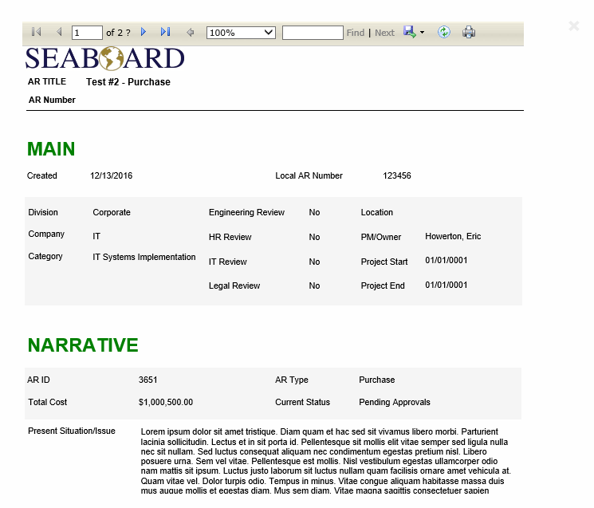
Print (new)

Slide 8
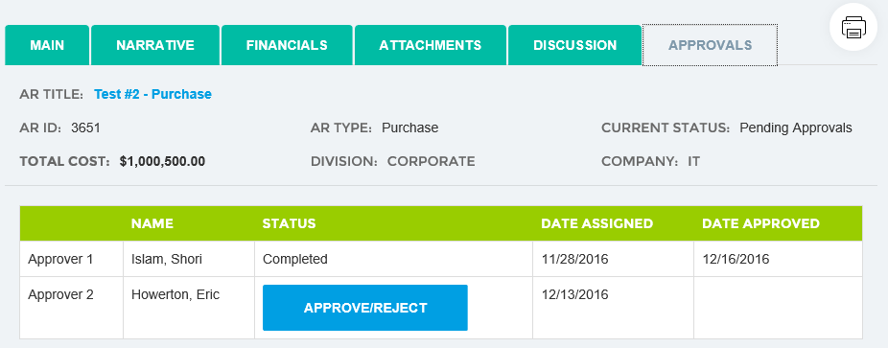
Approvals

